Slide 1
RESTFUL WEB SERVICES. POSTMERTEM
By-
Syed zafar shah
MANOHARA RAO PENUMALA
SNEHAL SHENDWARE

Slide 2
WALKTHROUGH
RECAPITULATION
SOAP VS REST
CURRENT TRENDS
FUTURE WORK
LESSONS LEARNT

Slide 3
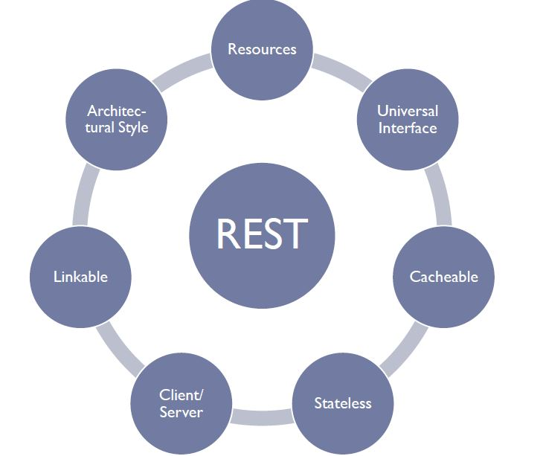
RECAPITULATION:
Design principles, Six constraints
Self descriptive messages, stateless (Dr.Gary’s famous def. )
Resources, URLs and Simple Operations
Idempotency : Multiple invocations doesn’t change state
GET, HEAD, PUT, DELETE, OPTIONS- Idempotent methods.
POST- Not idempotent.

Slide 4
SOAP VS REST

Slide 5
CURRENT TRENDS:

Slide 6
FUTURE WORK

Slide 7
LESSONS LEARNT

